Slide 1
Design
Ying shen
School of software engineering
Tongji university

Slide 2
Outline
Introduction
The Design Process
Design Frameworks
Design Methods
Design Tools, Practices, and Patterns
Social Impact Analysis
Legal Issues

Slide 3
Outline
Introduction
The Design Process
Design Frameworks
Design Methods
Design Tools, Practices, and Patterns
Social Impact Analysis
Legal Issues

Slide 4
Introduction
Design can be loosely defined as the outcome or the process of creating specifications for synthetic artifacts.
All manufactures objects are the result of some form of design process
User interfaces

Slide 5
Introduction
Now interaction design is defined as making plans and specifications for digital objects.
Early designs are highly functional but cruel to users.

Slide 6
Outline
Introduction
The Design Process
Design Frameworks
Design Methods
Design Tools, Practices, and Patterns
Social Impact Analysis
Legal Issues

Slide 7
The design process
Scenario-based design characterization:
Design is a process, not a state
The design process is nonhierarchical
The process is radically transformational
Design intrinsically involves the discovery of new goals

Slide 8
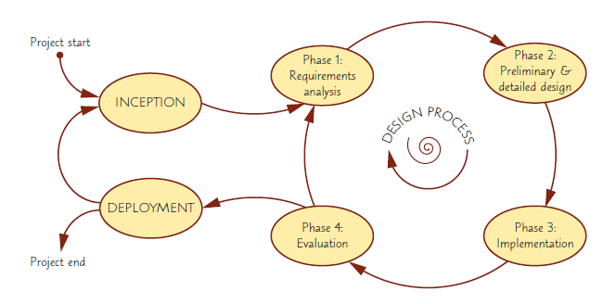
The design process
An iterative design process would consist of four distinct phases

Slide 9
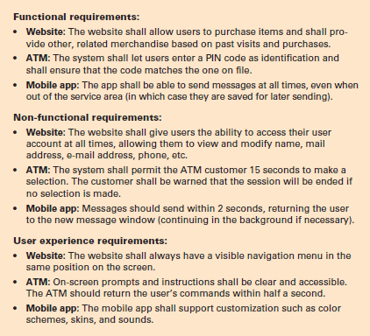
Phase 1 - Requirements analysis
Examples of requirements regarding system behavior for three distinct types of interactive systems:
E-commerce website
ATM
Mobile messaging app

Slide 10
Phase 2 – Preliminary and detailed design
The design phase in turn consists of two stages:
A preliminary stage, where the high-level design or architecture of the interactive system is derived
A detailed stage, where the specifics of each interaction is planned out
The preliminary stage is also called architectural or conceptual design
Examples of suitable design methods include sketching, paper mockups, and high-fidelity prototypes
Can be clarified via tools, patterns, best practices

Slide 11
Phase 3 – Build and implementation
Where all the planning gets turned into actual, running code
The actual software and hardware engineering needed to achieve this are outside the scope of this book
Included in this text is software development platforms for interactive applications for mobile apps, the web and PC’s
Make sure to evaluate tool capabilities, ease of use, ease to learn, cost, and performance
Tailor tool choices for the size of the job

Slide 12
Phase 4 – Evaluation
Developers test and validate the system implementation to ensure that it conforms to the requirements and design set out earlier in the process
Chapter 5 covers a range of suitable evaluation methods for this phase in depth

Slide 13
Outline
Introduction
The Design Process
Design Frameworks
Design Methods
Design Tools, Practices, and Patterns
Social Impact Analysis
Legal Issues

Slide 14
Design frameworks
User-centered design (UCD)
Takes the needs, wants, and limitations of the actual end users into account during each phase of the design process
Participatory design (PD)
Direct involvement of people in the collaborative design of the things and technologies they use
Agile interaction design
Development methods for self-organizing, dynamic teams and that facilitate flexible, adaptive, and rapid development that is robust to changing requirements and needs

Slide 15
User-centered design
UCD prescribes a design process that primarily takes the needs, wants, and limitations of the actual end users into account
Systems generate fewer problems during development and have lower maintenance costs
General phases of User-Centered Design process
Specify context of use
Specify Requirements
Create Design solutions and development
Evaluate Product

Slide 16
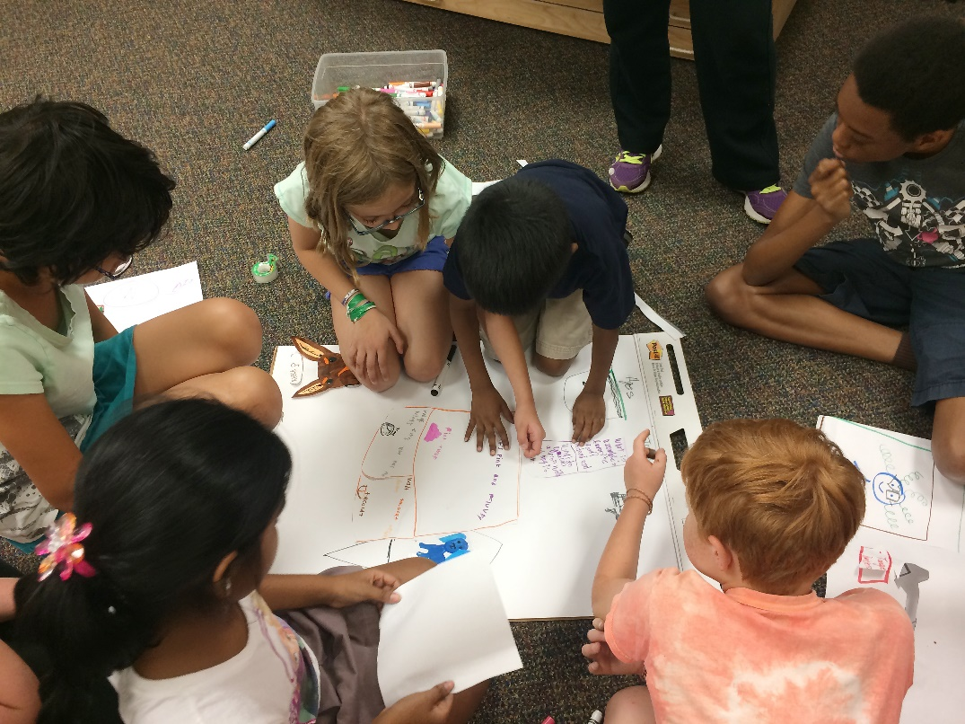
Participatory design
Intergenerational and interdisciplinary design team from the University of Maryland’s KidsTeam working on new human-computer interaction technologies using paper prototypes

Slide 17
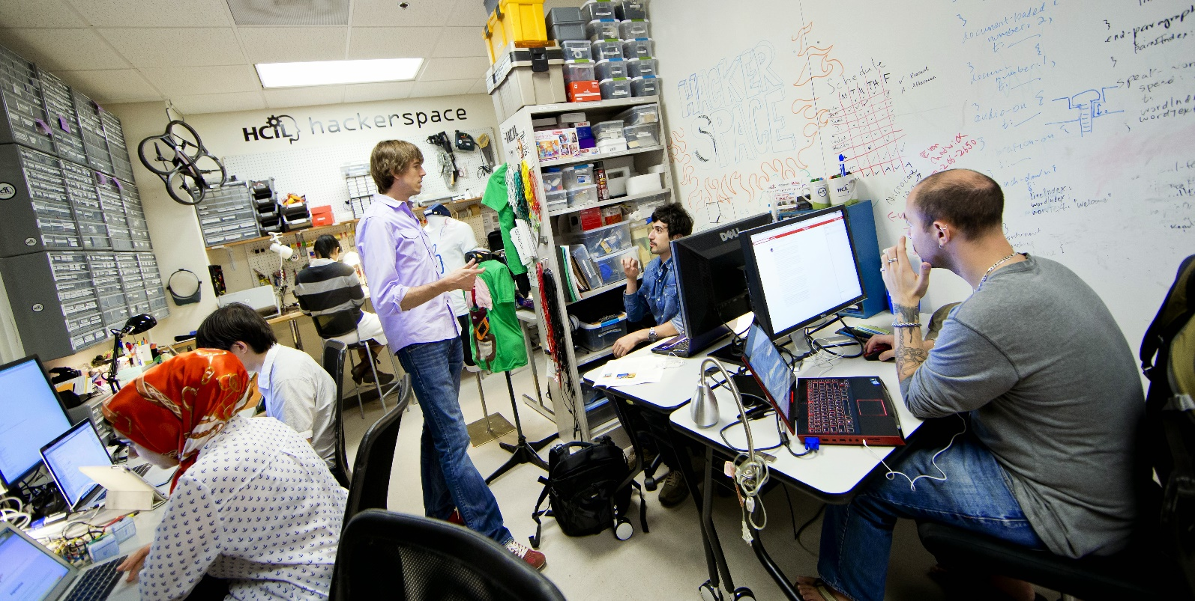
Agile interaction design
Professor Jon Froehlich and his students working in the HCIL Hackerspace at University of Maryland, College Park

Slide 18
Outline
Introduction
The Design Process
Design Frameworks
Design Methods
Design Tools, Practices, and Patterns
Social Impact Analysis
Legal Issues

Slide 19
Design methods
Practical building blocks that form the actual day-to-day activities in the design process
Ideation and creativity
Surveys, interviews and focus groups
Ethnographic observation
Scenario development and storyboarding
Prototyping

Slide 20
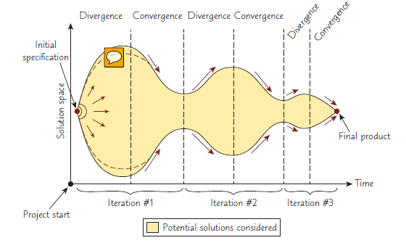
Design methods
Illustration of how the solutions considered during a design process will grow (diverge) and shrink (converge) iteratively until it eventually fixates on a single point, the finished product
This particular design process involves three iterations, but real processes may have more or fewer iterations.

Slide 21
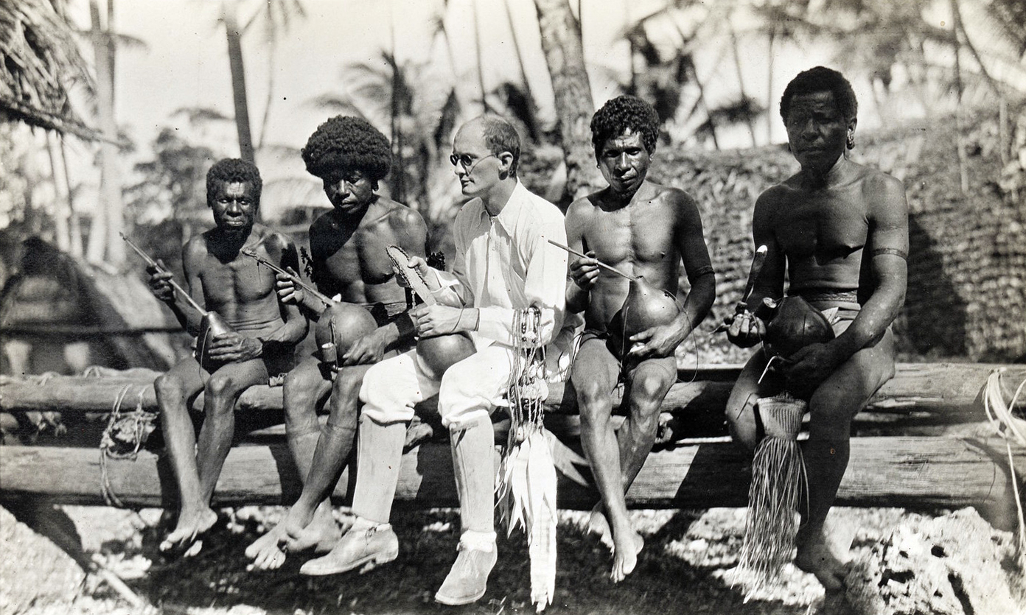
Ethnographic observation
Malinowski with natives, Trobriand Islands, 1918

Slide 22
Ethnographic observation
Preparation
Understand organization policies and work culture
Familiarize yourself with the system and its history
Set initial goals and prepare questions
Gain access and permission to observe/interview
Field Study
Establish rapport with managers and users
Observe/interview users in their workplace and collect subjective/objective quantitative/qualitative data
Follow any leads that emerge from the visits

Slide 23
Ethnographic observation
Analysis
Compile the collected data in numerical, textual, and multimedia databases
Quantify data and compile statistics
Reduce and interpret the data
Refine the goals and the process used
Reporting
Consider multiple audiences and goals
Prepare a report and present the findings

Slide 24
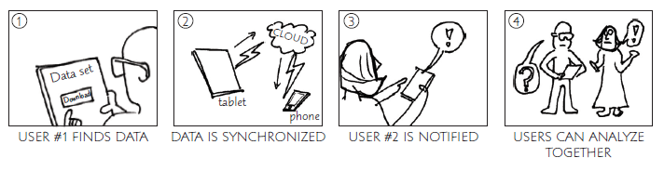
Storyboarding
Hand-drawn storyboard for a collaborative software that allows multiple people to view a common dataset using their personal smartphones and tablets

Slide 25
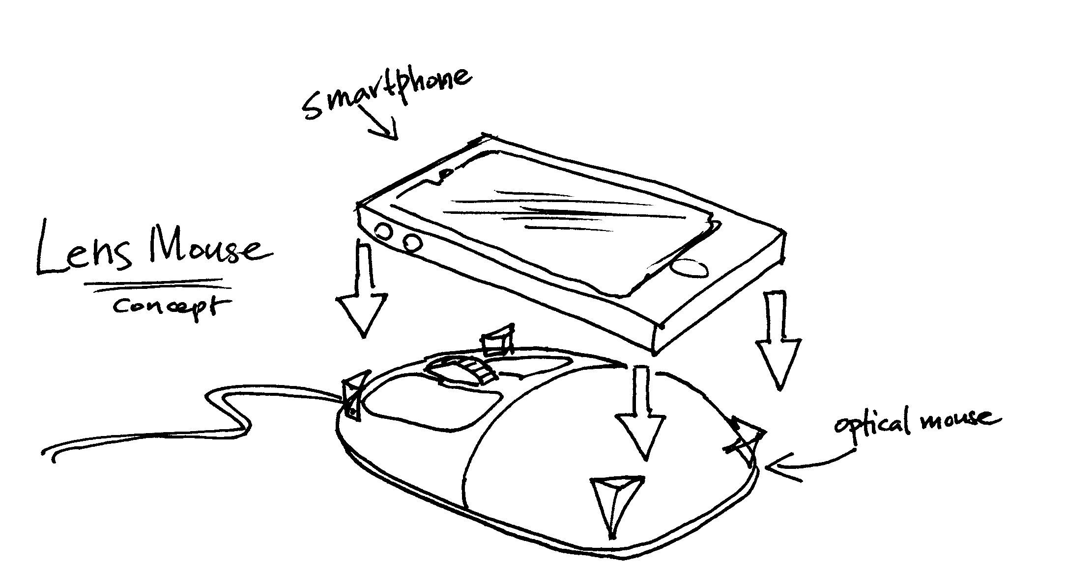
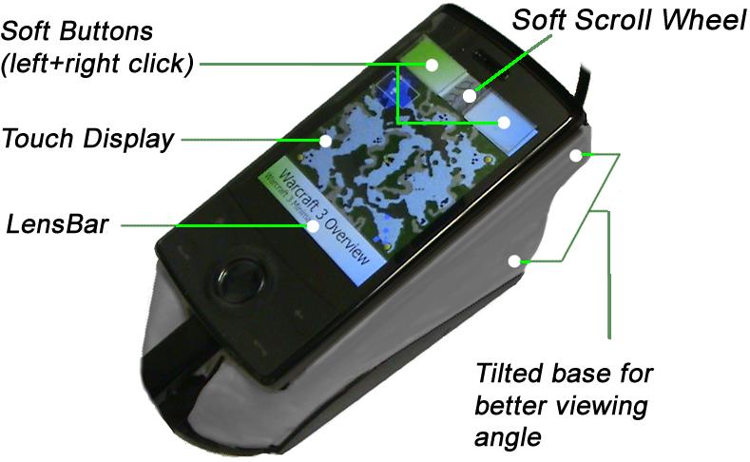
Prototyping
Low-fidelity prototypes are generally created by sketching, using post-it notes, or cutting and gluing pieces of paper together (paper mockups)
Medium-fidelity prototypes are often called wireframes, and provide some standardized elements (such as buttons, menus, and text fields), even if potentially drawn in a sketchy fashion, and has some basic navigation functionality
High-fidelity prototypes look almost like the final product and may have some rudimentary computational capabilities; however, the prototype is typically not complete and may not be fully functional

Slide 26
Outline
Introduction
The Design Process
Design Frameworks
Design Methods
Design Tools, Practices, and Patterns
Social Impact Analysis
Legal Issues

Slide 27
Design tools
Dedicated prototyping design tools are specifically designed for the purpose of creating interface mockups rapidly and effortlessly
Design Tools
MS PowerPoint presentation
Adobe InDesign
Photoshop
Illustrator

Slide 28
Design patterns
Interaction Design Patterns
Best-practice solutions to commonly occurring problems specified in such a way that they can be reused and applied to slightly different variations of a problem over and over again
Model-View-Controller (MVC), document interface, Web app page architecture

Slide 29
Outline
Introduction
The Design Process
Design Frameworks
Design Methods
Design Tools, Practices, and Patterns
Social Impact Analysis
Legal Issues

Slide 30
Social impact analysis
Describe the new system and its benefits
Convey the high level goals of the new system
Identify the stakeholders
Identify specific benefits

Slide 31
Social impact analysis
Address concerns and potential barriers
Anticipate changes in job functions and potential layoffs
Address security and privacy issues
Discuss accountability and responsibility for system misuse and failure
Avoid potential biases
Weigh individual rights vs. societal benefits
Assess trade-offs between centralization and decentralization
Preserve democratic principles
Ensure diverse access
Promote simplicity and preserve what works

Slide 32
Social impact analysis
Outline the development process
Present and estimated project schedule
Propose process for making decisions
Discuss expectations of how stakeholders will be involved
Recognize needs for more staff, training, and hardware
Propose plan for backups of data and equipment
Outline plan for migrating to the new system

Slide 33
Outline
Introduction
The Design Process
Design Frameworks
Design Methods
Design Tools, Practices, and Patterns
Social Impact Analysis
Legal Issues

Slide 34
Legal issues
Potential Controversies
What material is eligible for copyright?
Are copyrights or patents more appropriate for user interfaces?
What constitutes copyright infringement?
Should user interfaces be copyrighted?
Evolving public policies related to:
Privacy
Liability related to system safety/reliability
Freedom of speech

